Slide 1
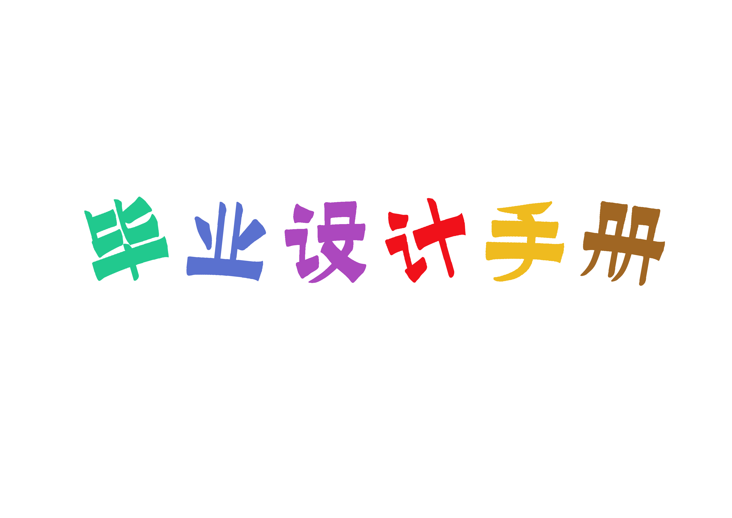
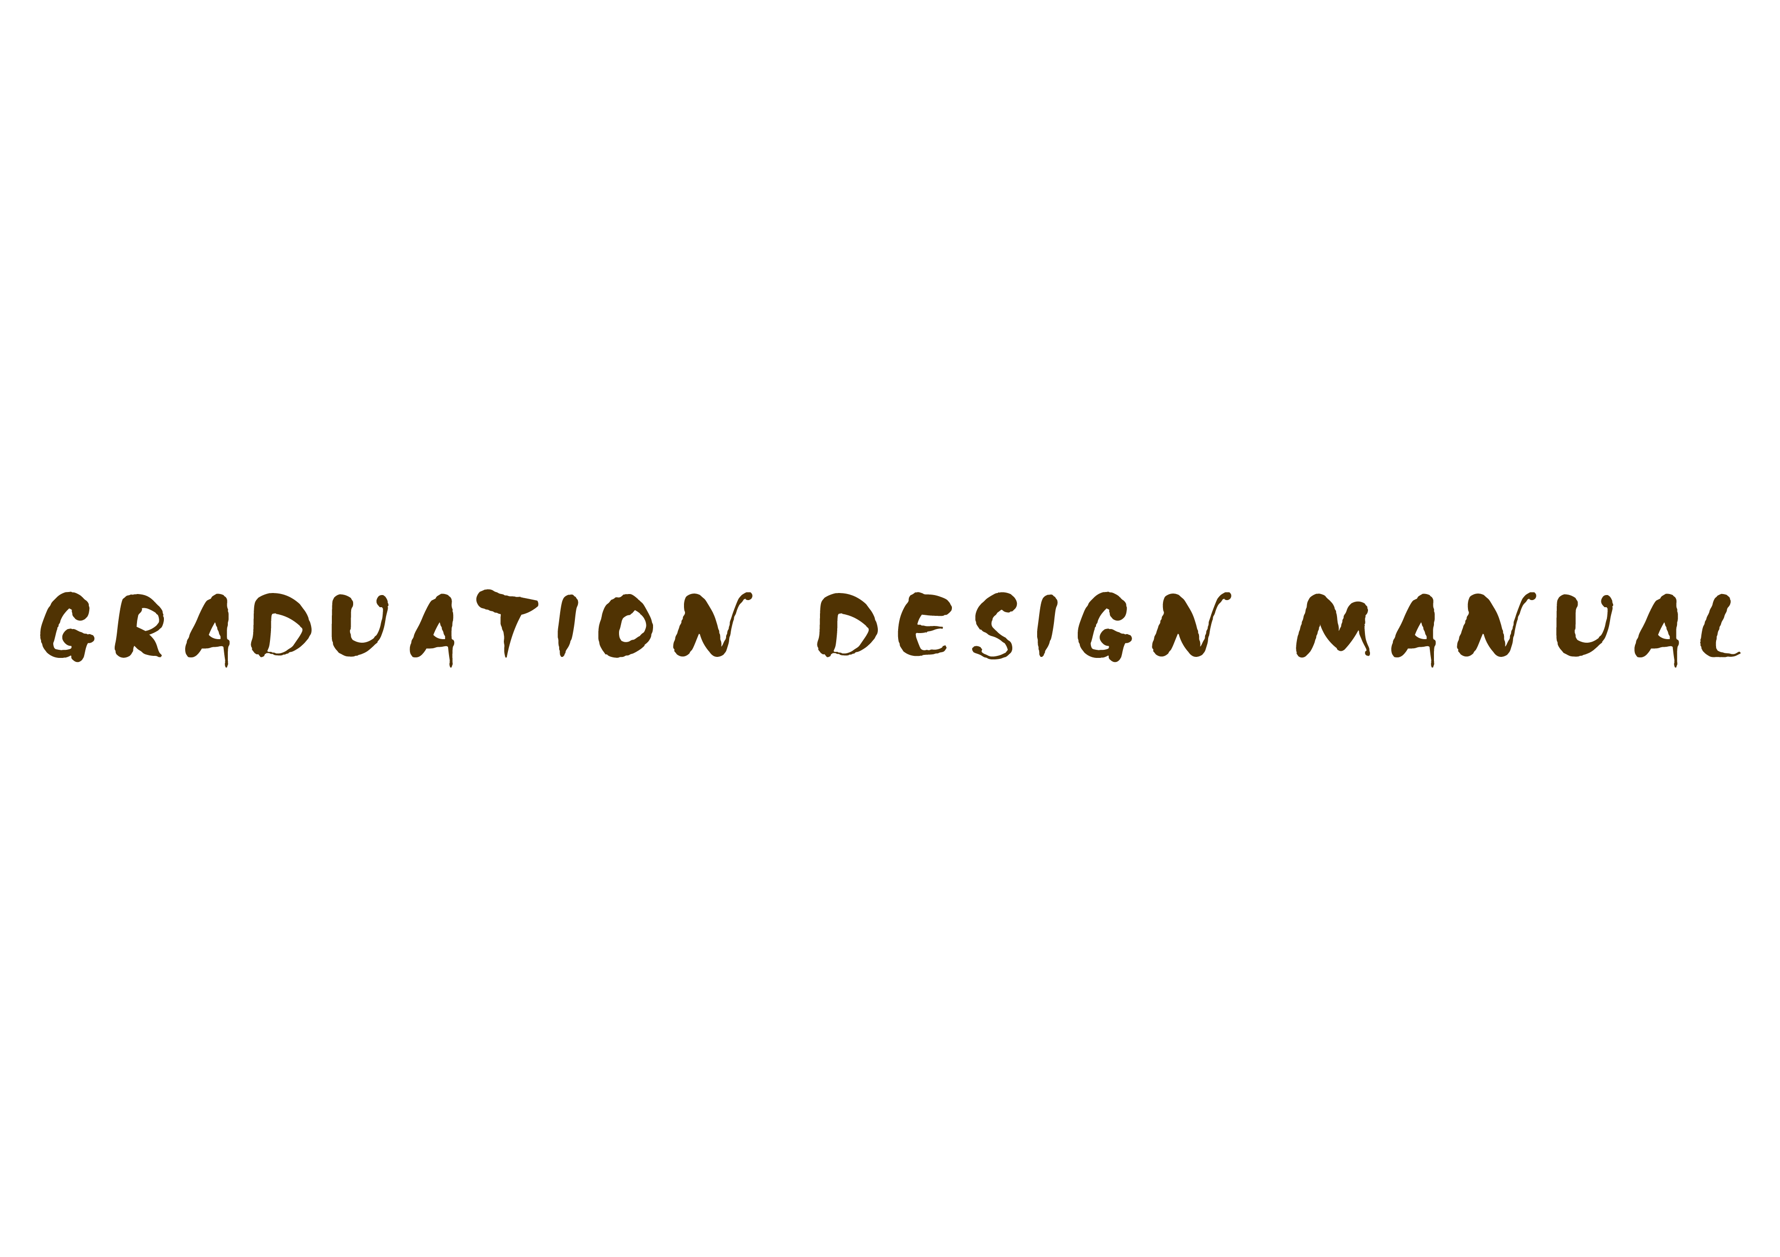
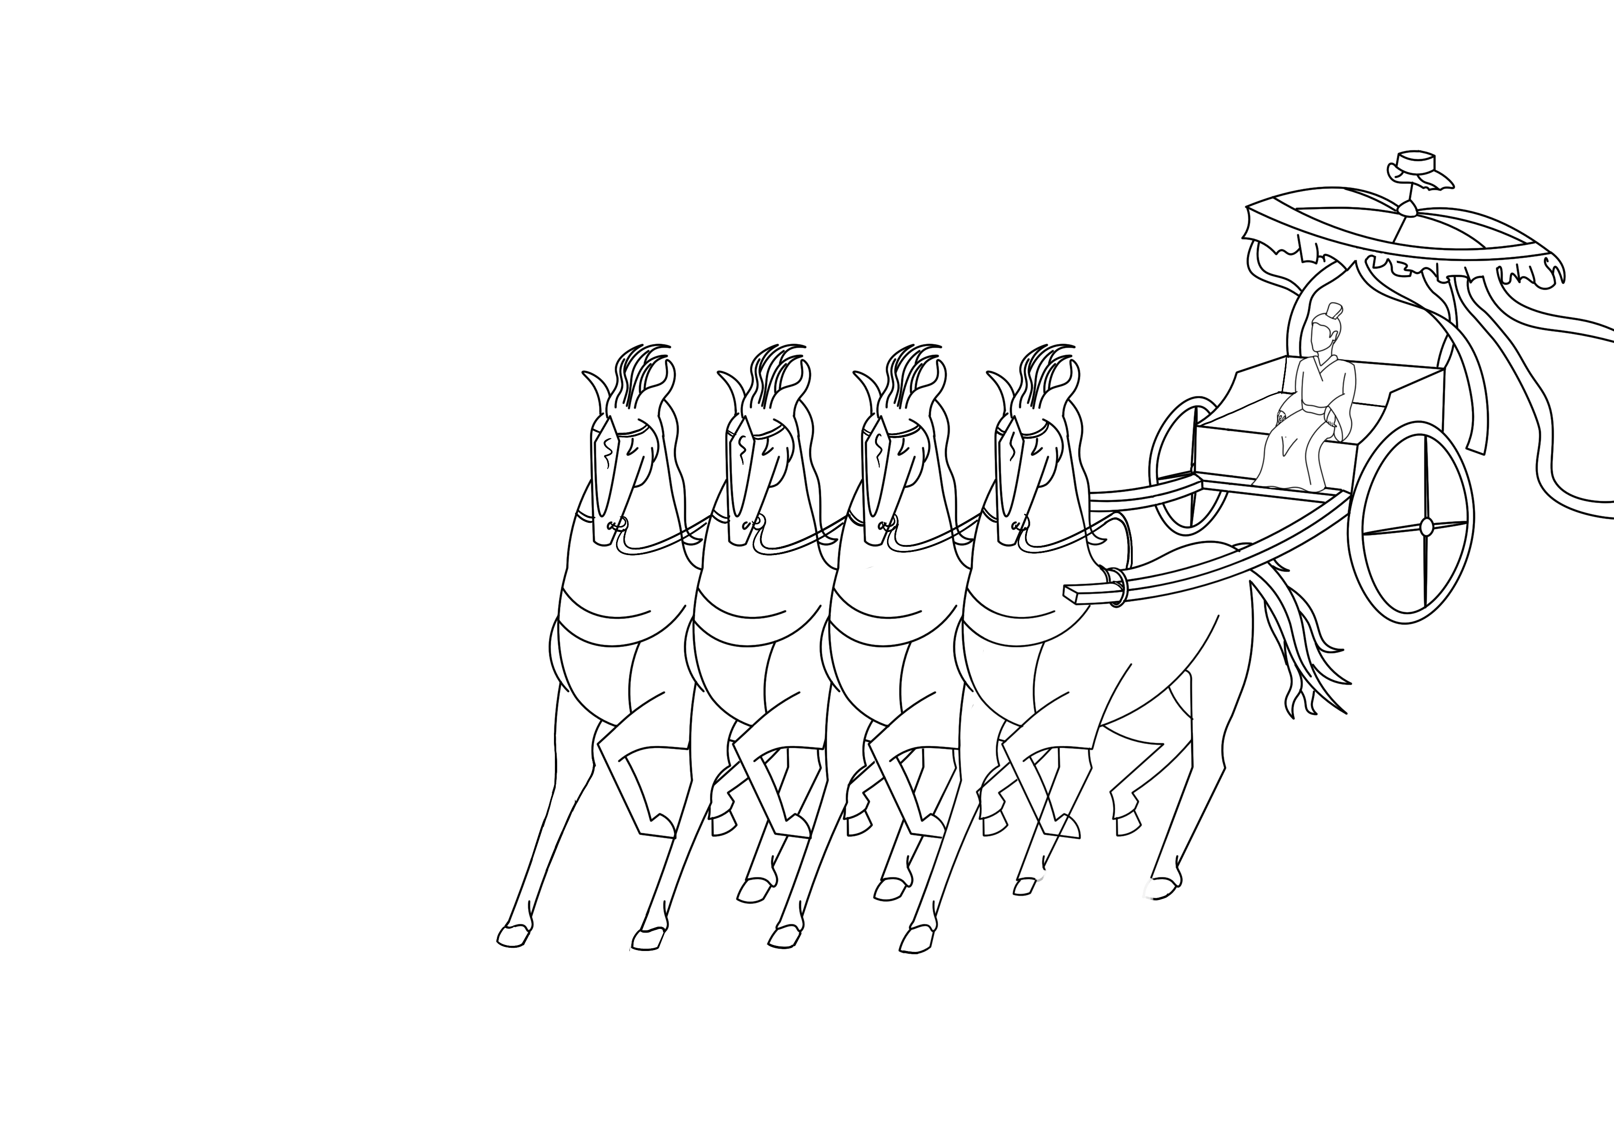
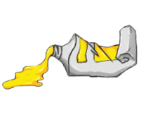

Slide 4
1.1创作介绍
海昏侯墓的发掘引起了社会的广泛关注。墓葬出土面积之广泛，文物之琳琅满目，文化之内涵
之深厚，财富之富可敌国，该墓葬对研究西汉历史具有重大且独特的意义。本篇文章则是通过
视觉传达设计中的一个重要分支——插画，对海昏文化进行文化的弘扬及传播。探讨了插画对
于视觉传达的意义，从而探索了现代插画与历史文化的碰撞，海昏文化在视觉传达设计中的实
际应用。
The excavation of haihunhou tomb has aroused widespread concern in the society. The
burial is of great and unique significance for the study of the history of the Western Han
Dynasty because of its extensive unearthed area, rich cultural relics, profound cultural
connotation and wealth. This article is to carry forward and spread haihun culture through
illustration, an important branch of visual communication design. This paper discusses
the significance of illustration for visual communication, and explores the collision between
modern illustration and historical culture, and the application of Haihun culture in visual
communication design.

Slide 5
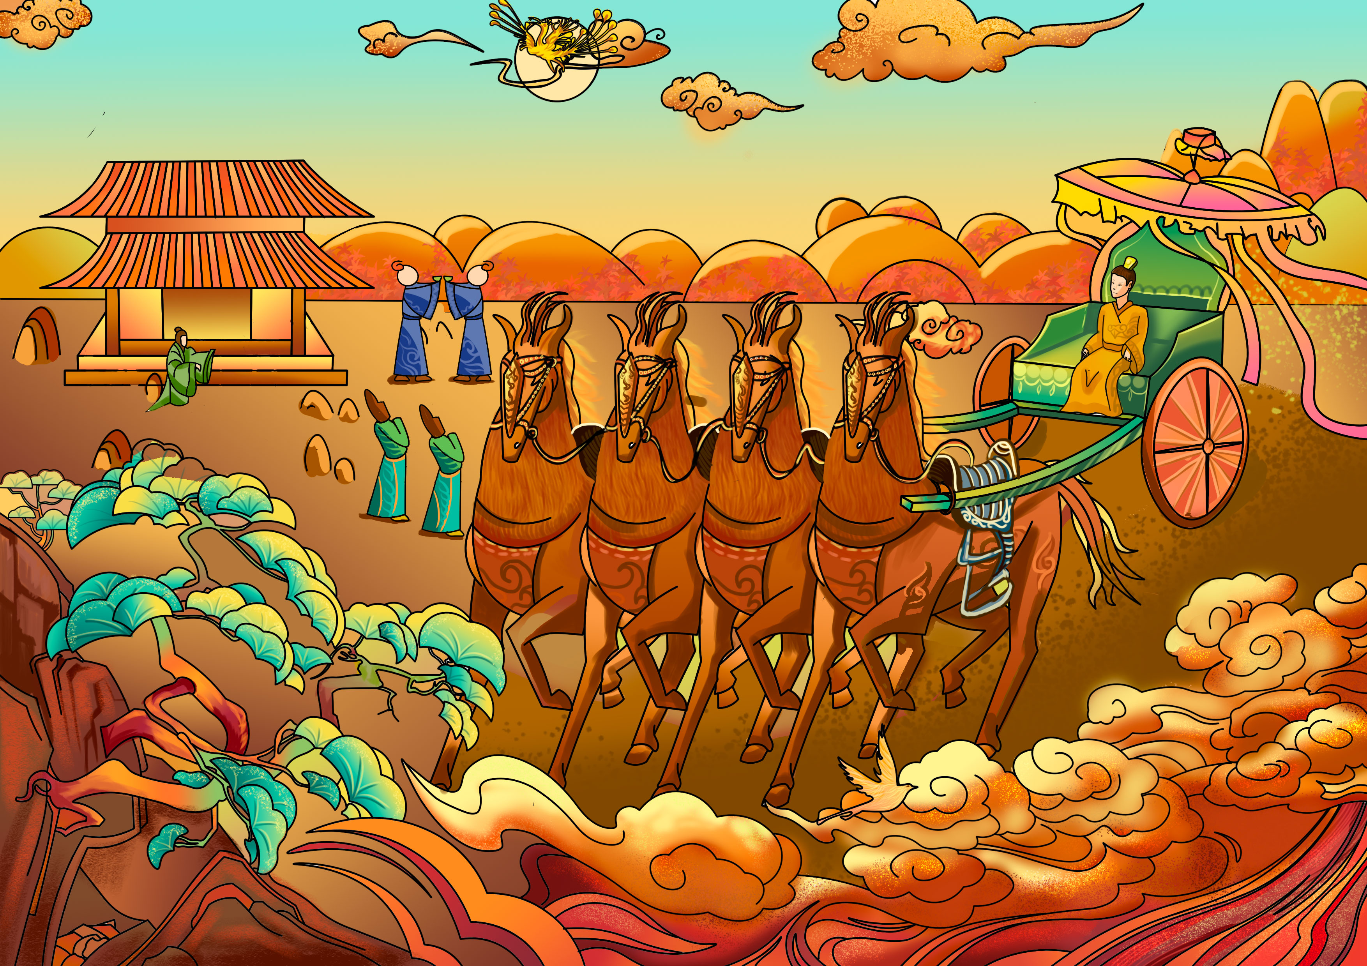
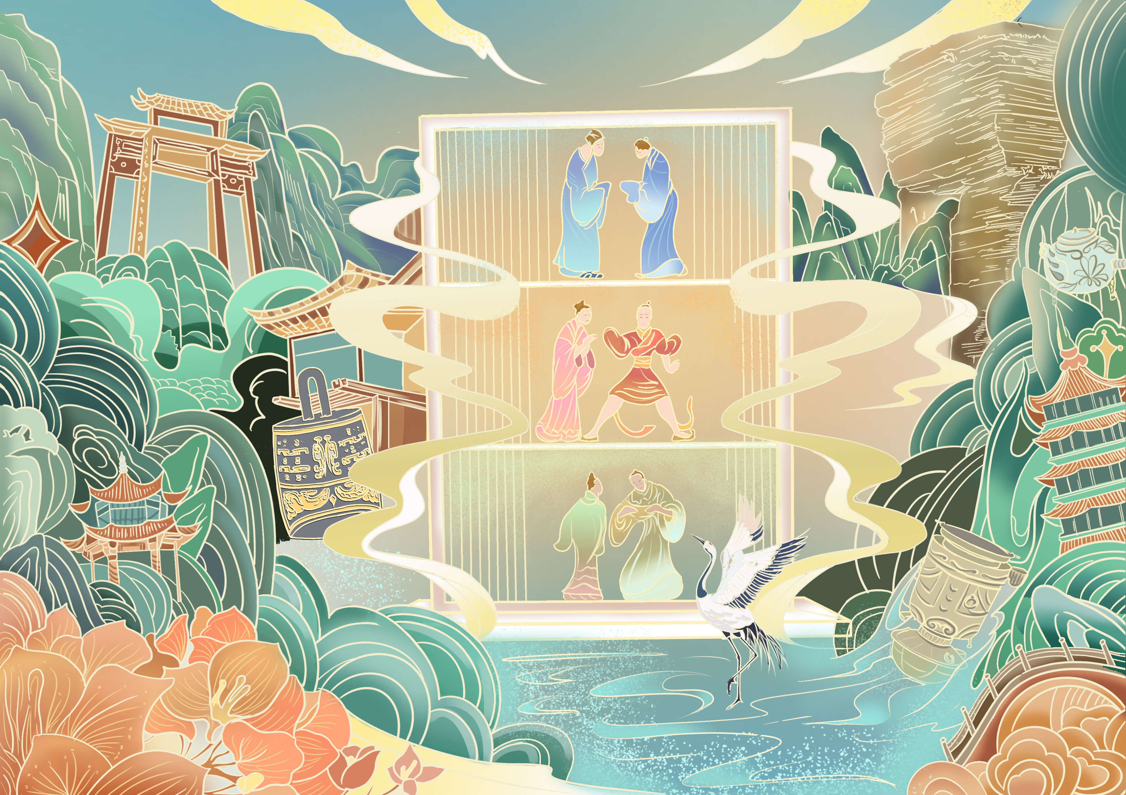
1.2画面组成

Slide 6
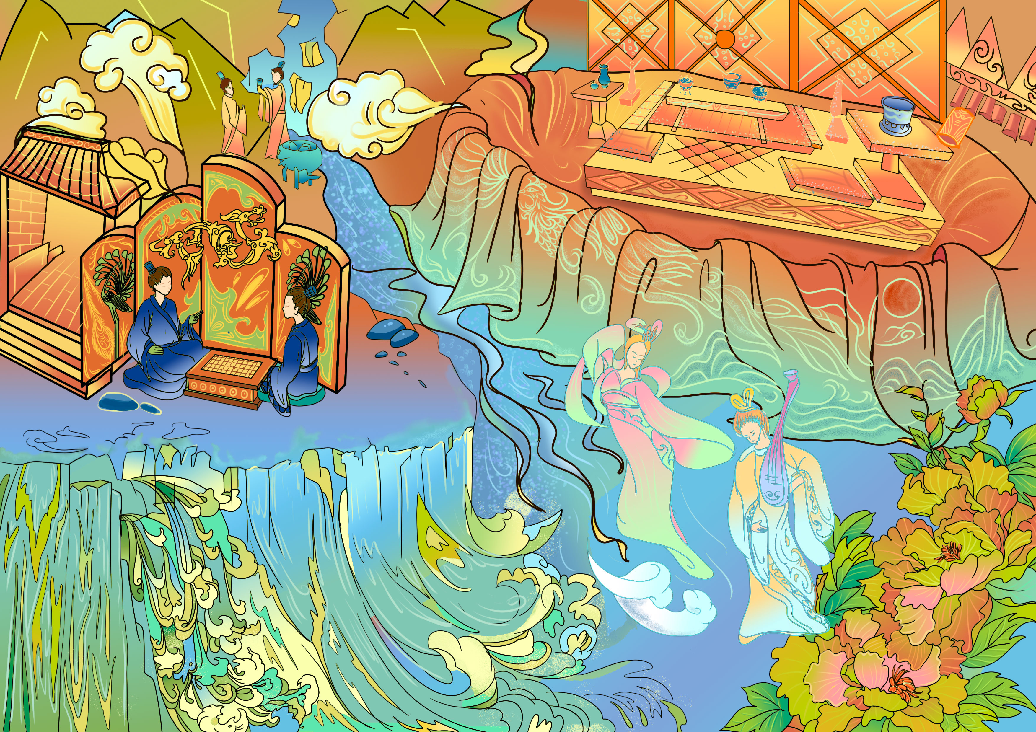
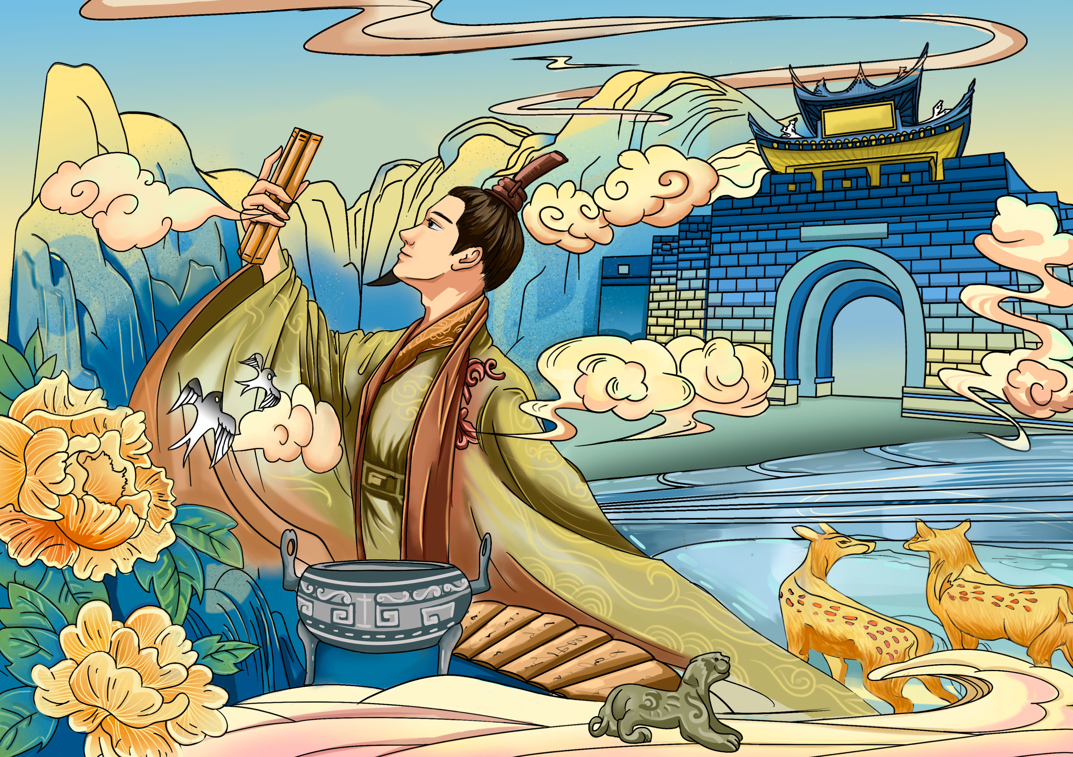
1.2画面组成

Slide 7
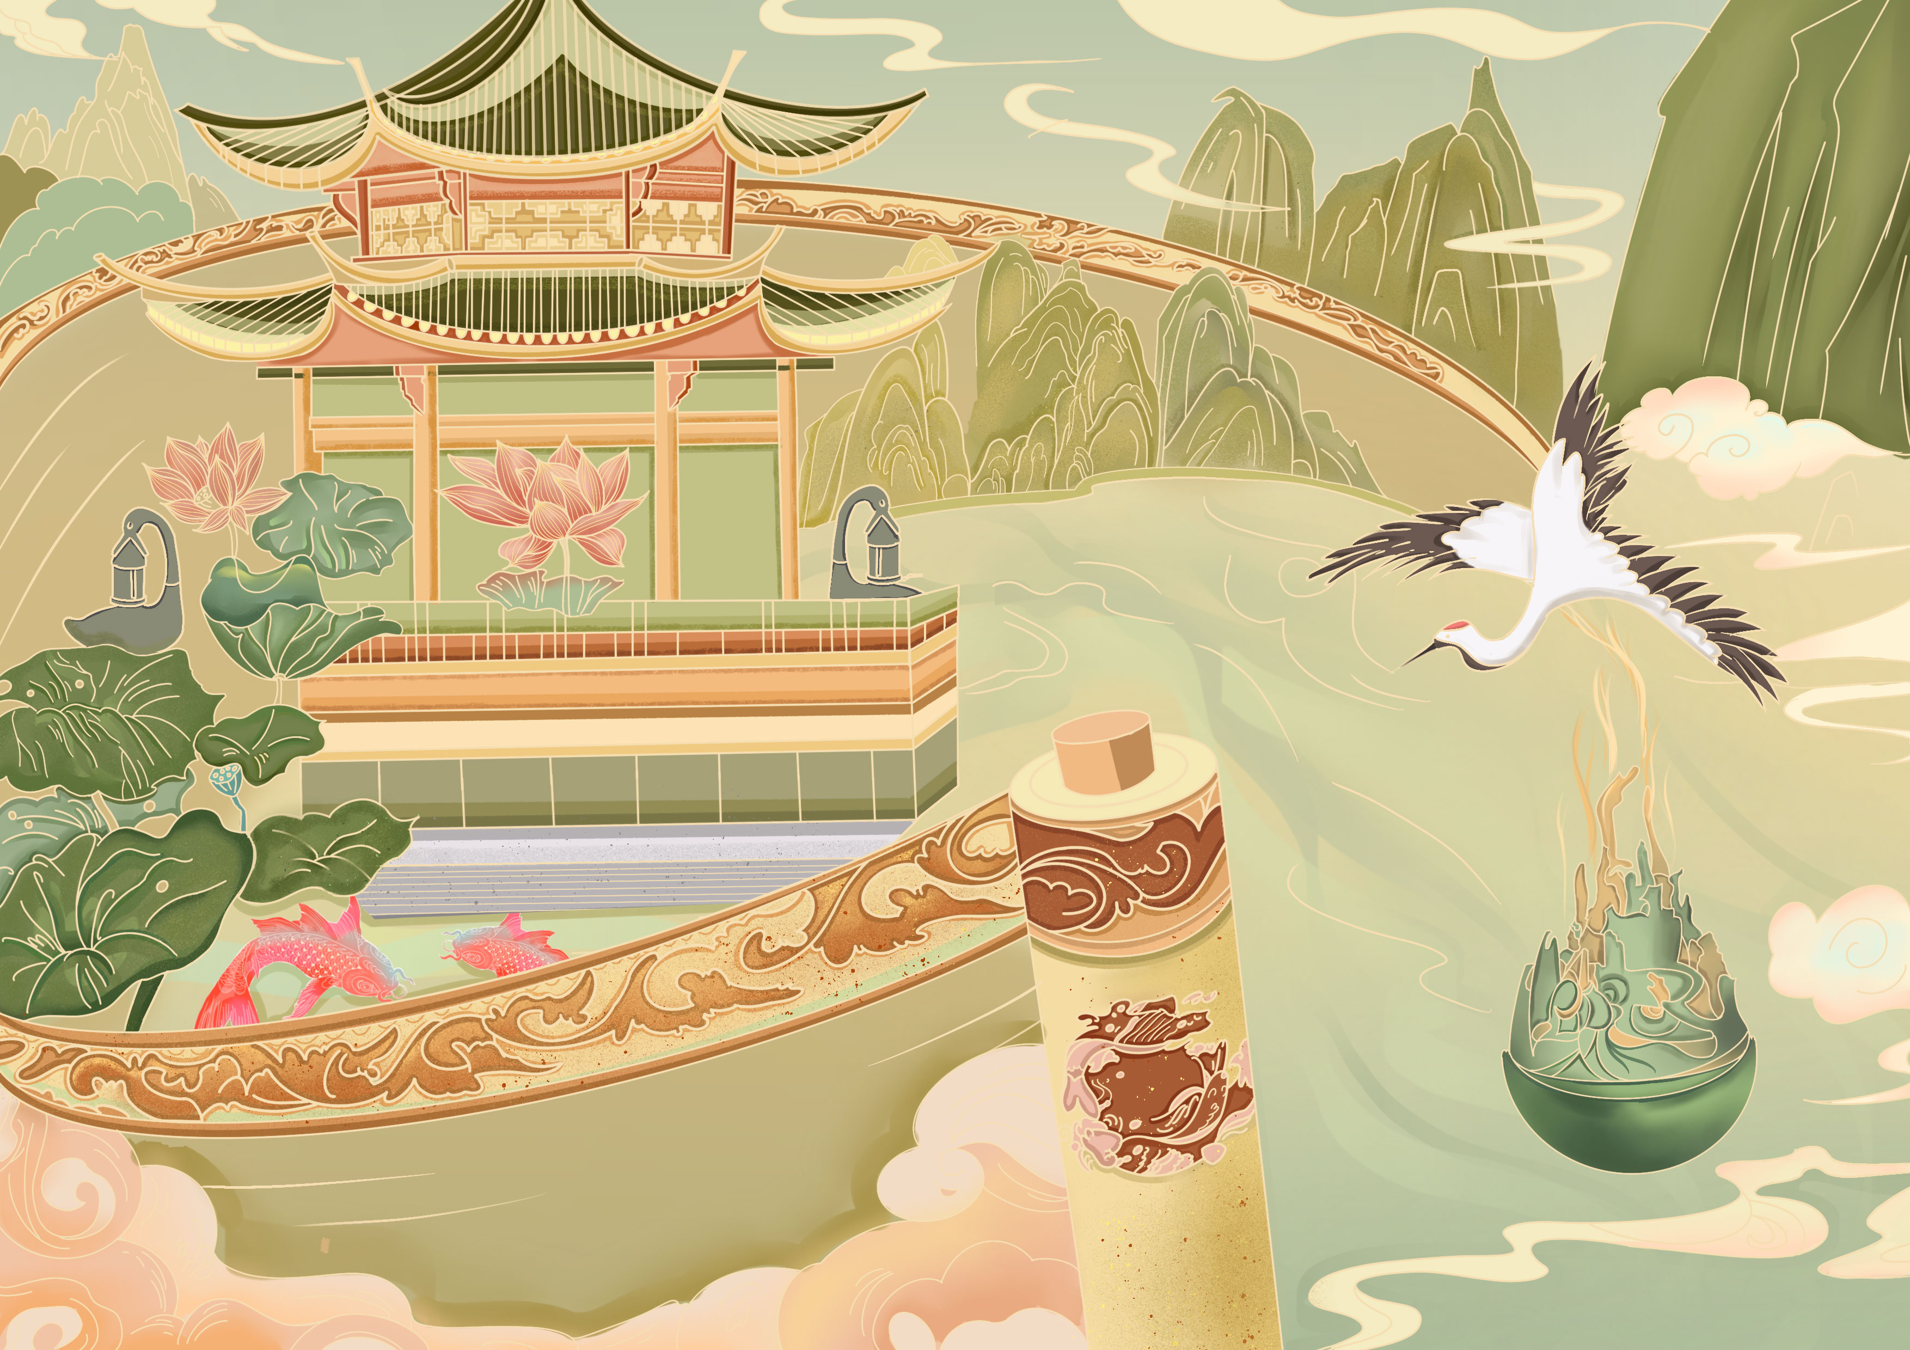
1.2画面组成

Slide 8
1.3插画衍生系列插画

Slide 10
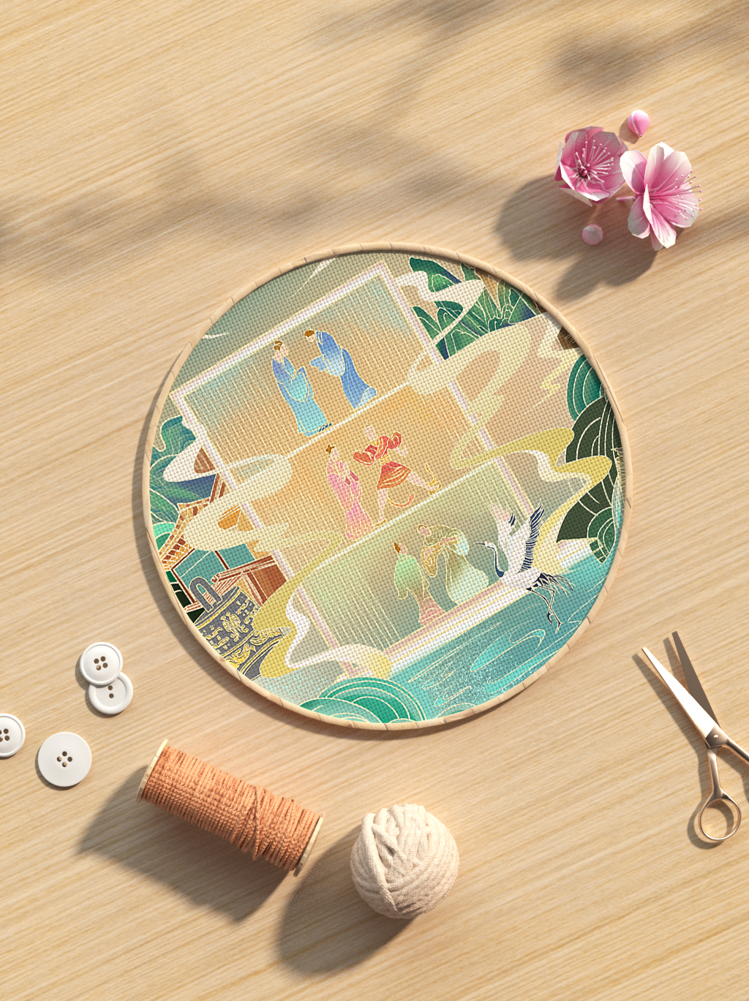
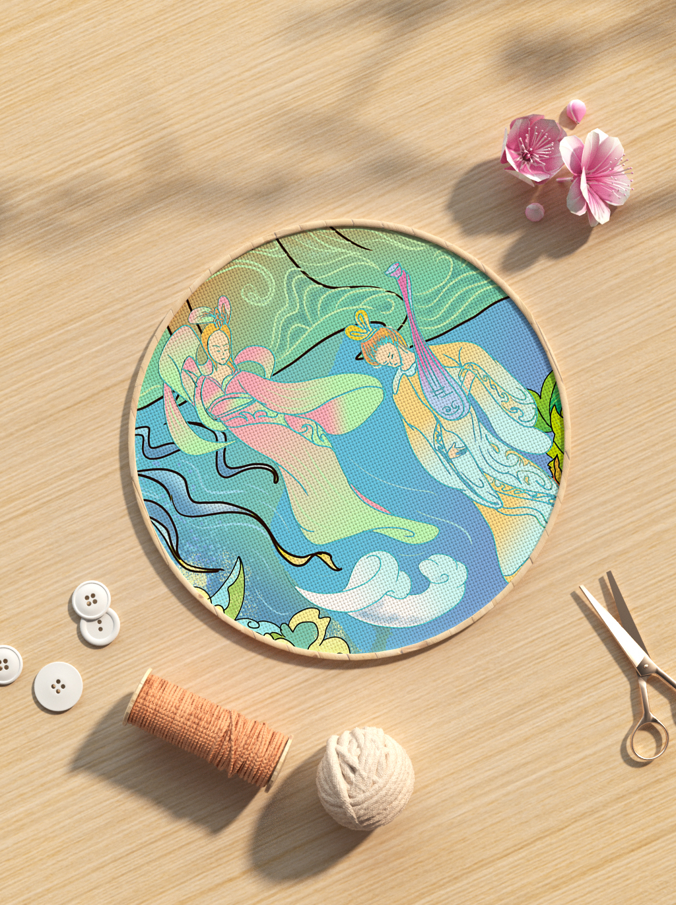
2.1海昏刺绣

Slide 11
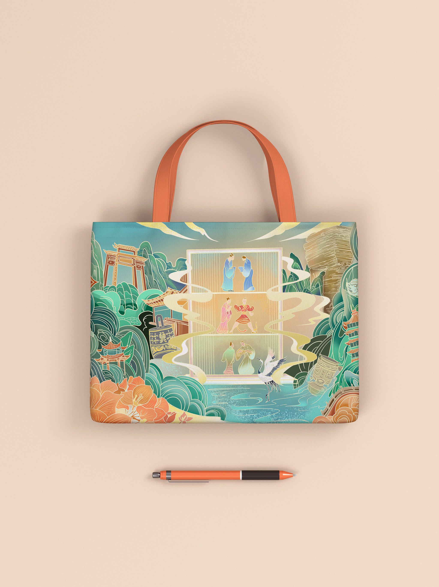
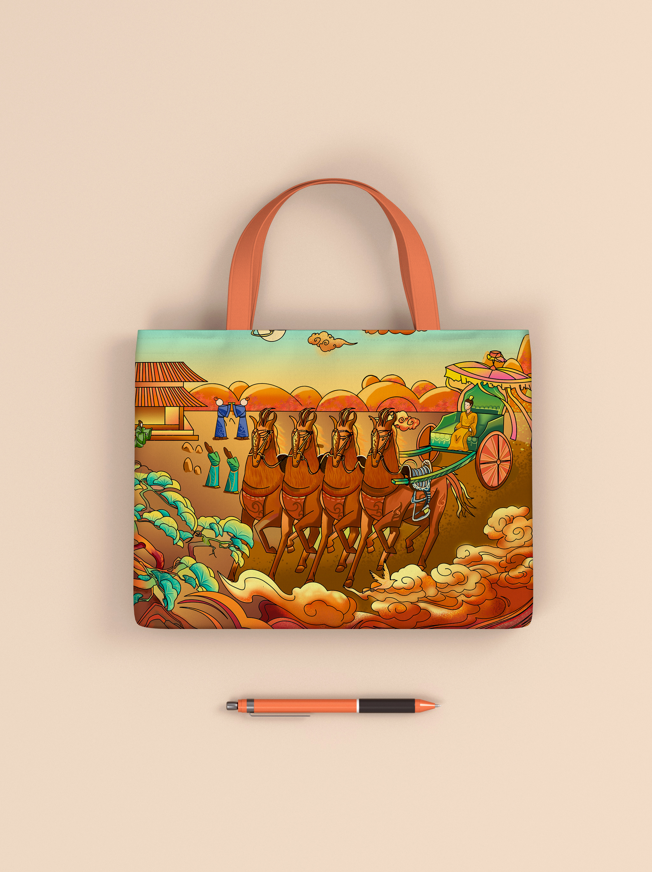
2.2联名帆布包

Slide 12
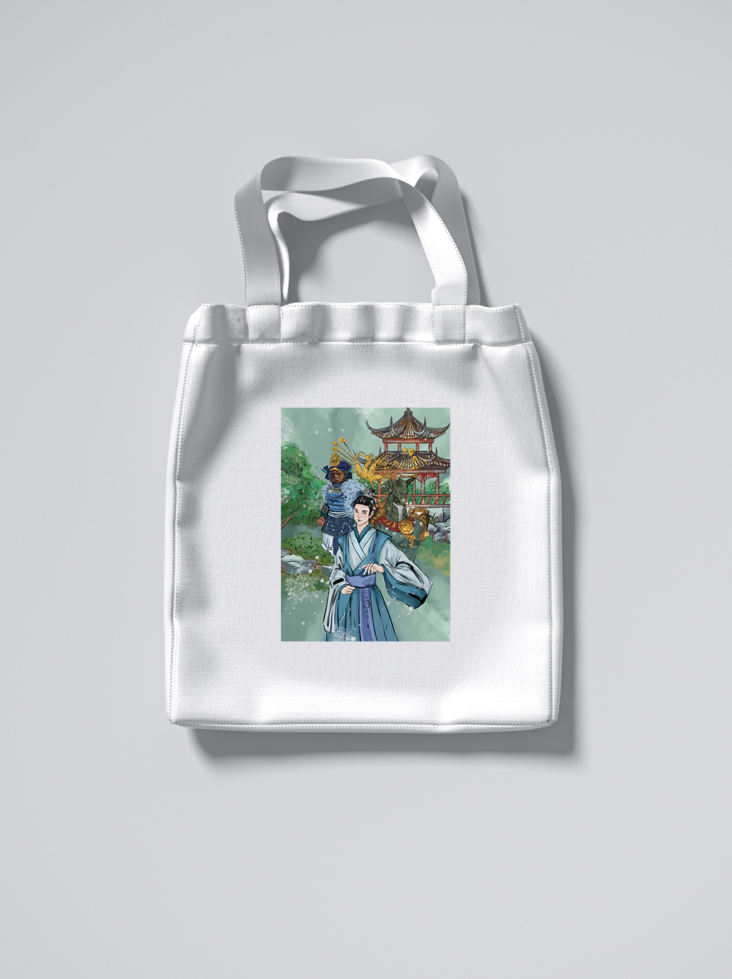
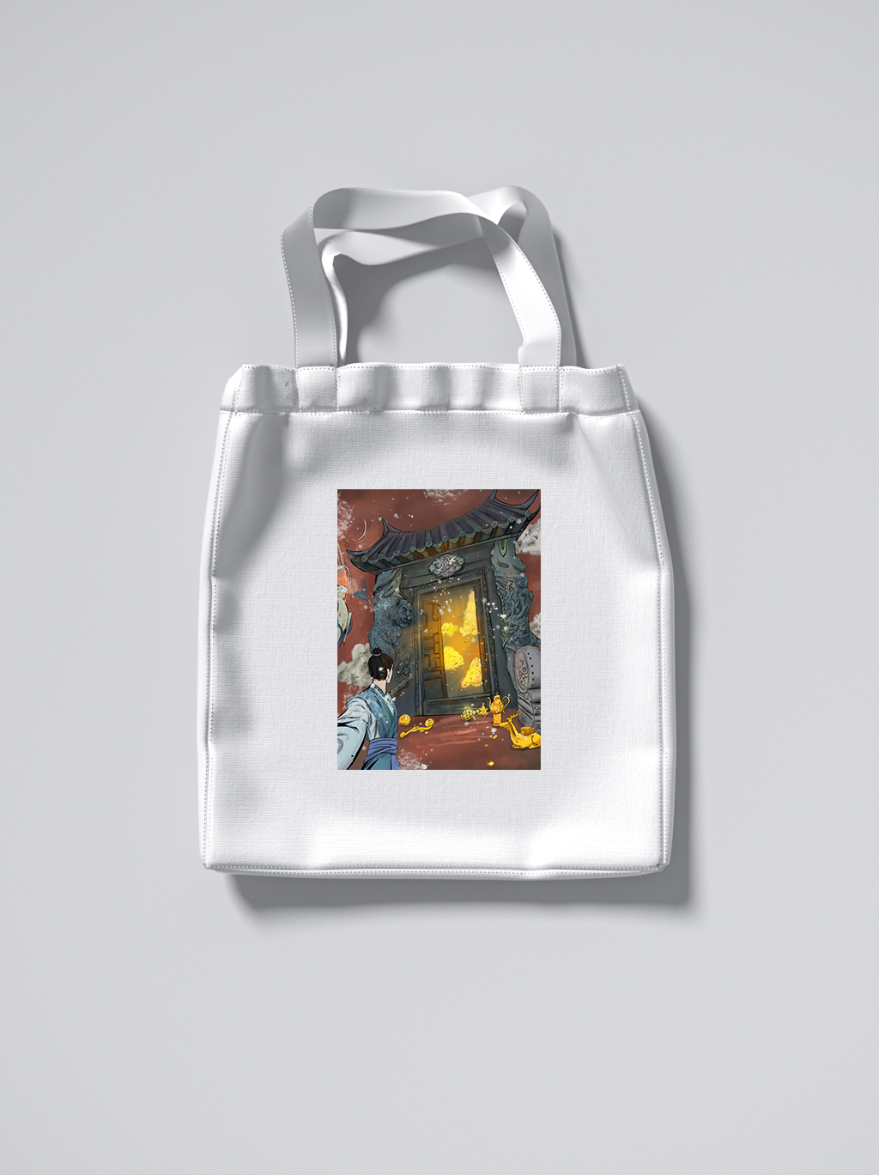
2.3联名手提包

Slide 13
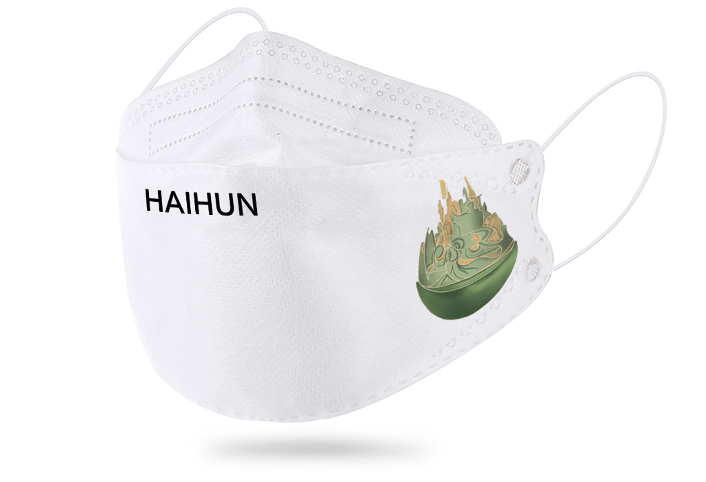
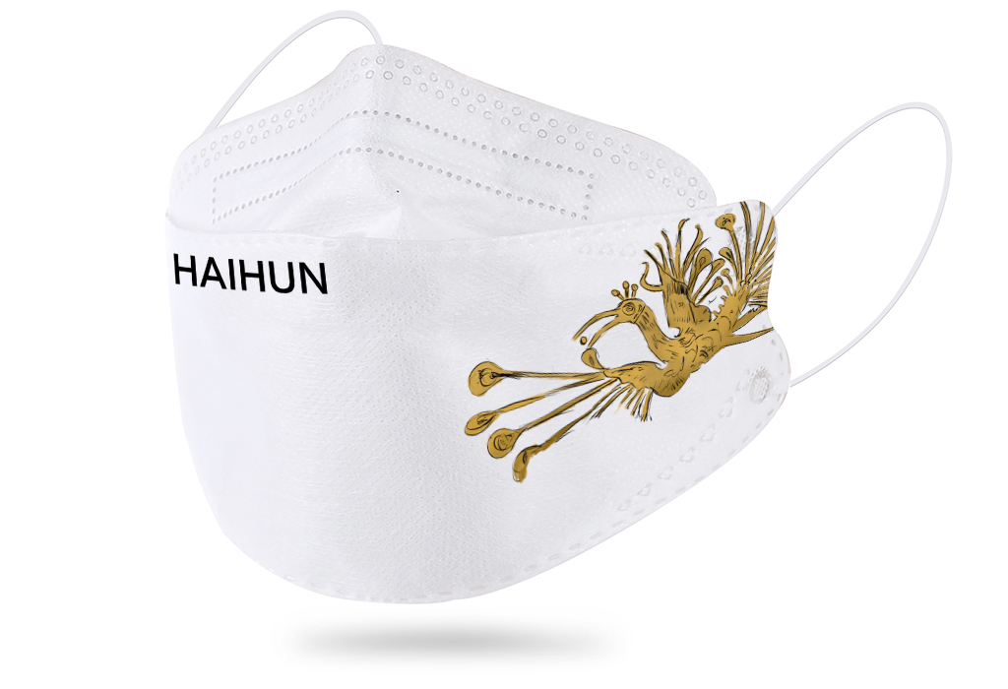
2.4周边口罩

Slide 14
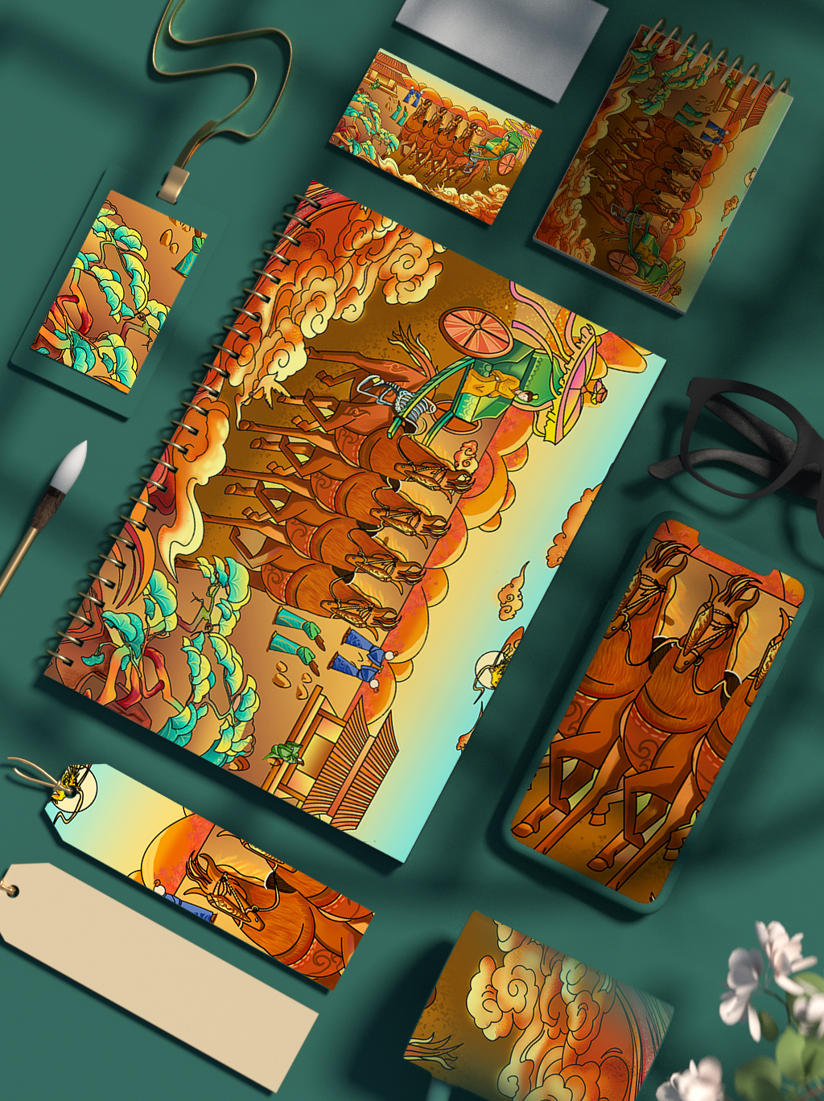
2.5海昏文创系列

Slide 15
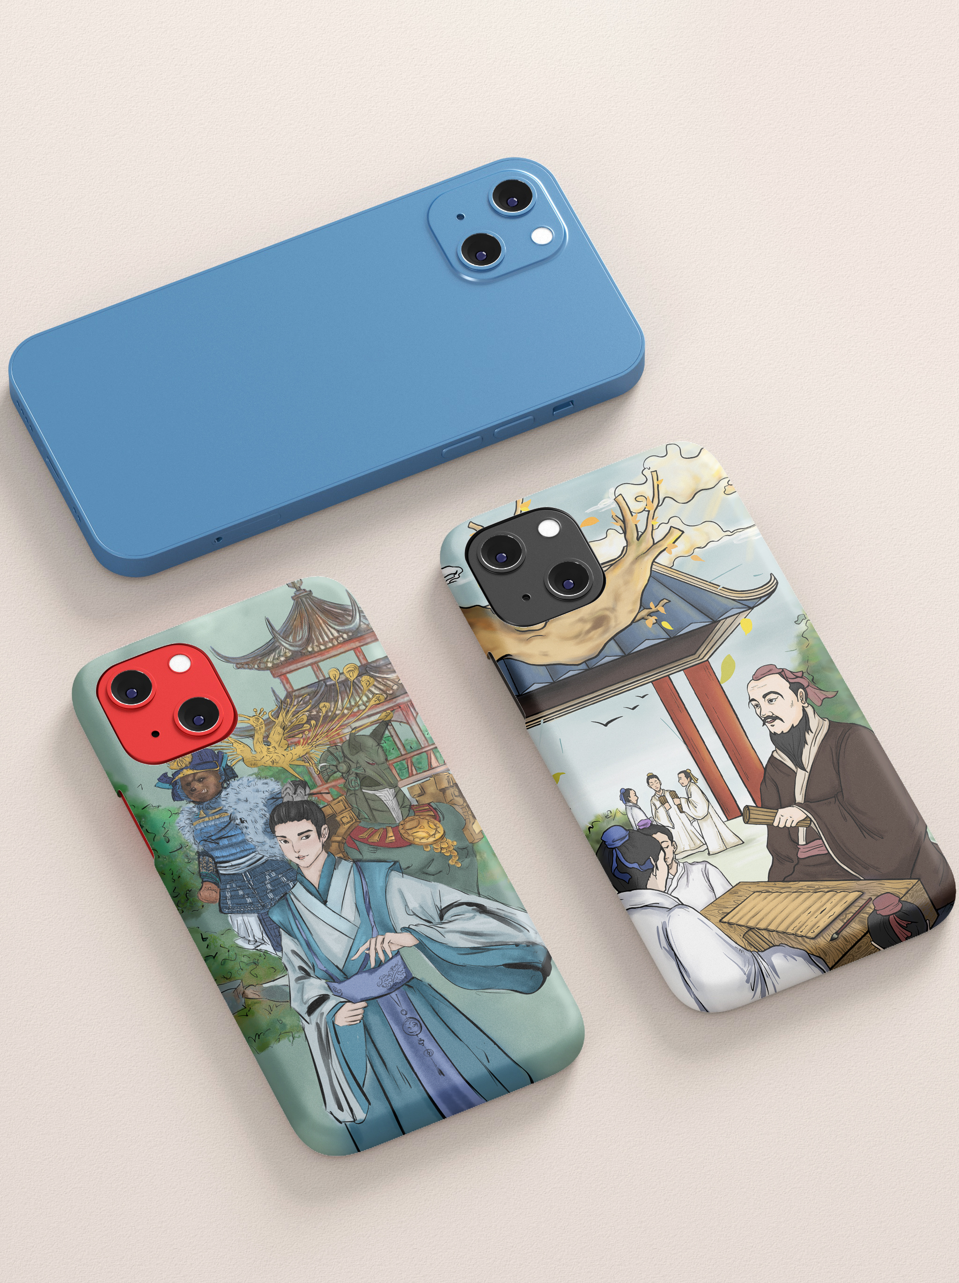
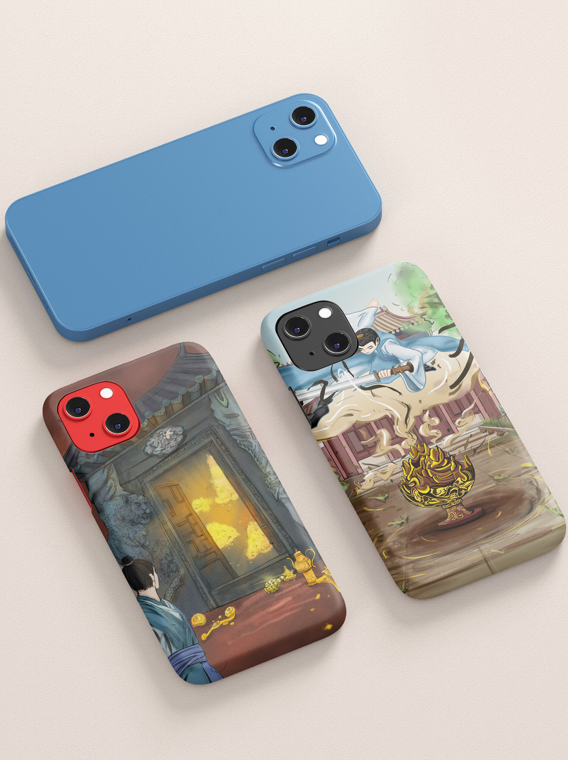
2.6海昏文化手机壳

Slide 16
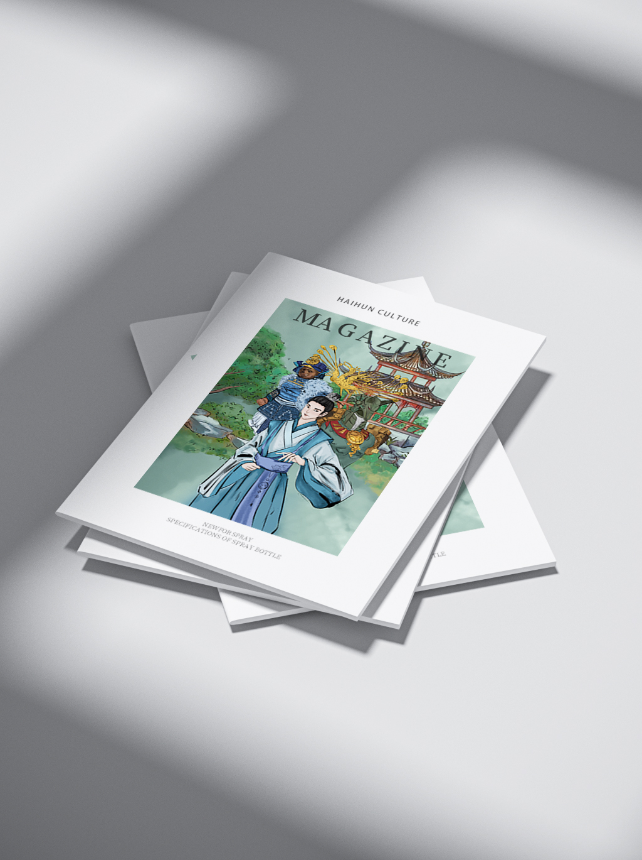
2.7海昏杂志

Slide 17
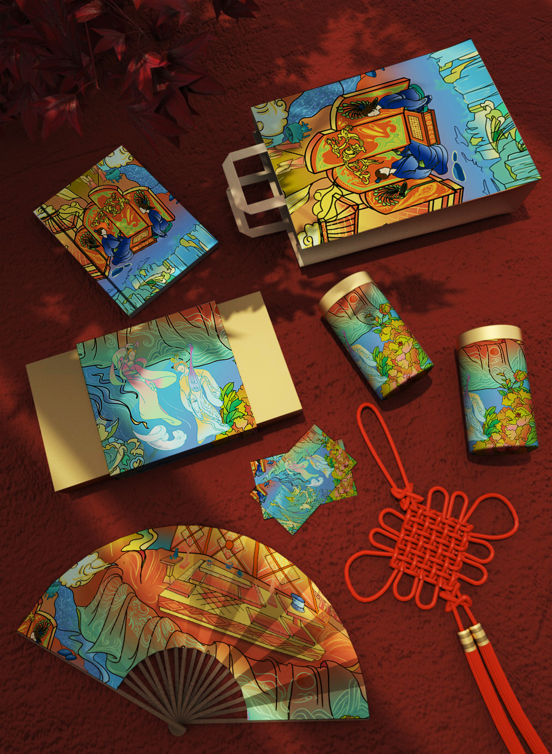
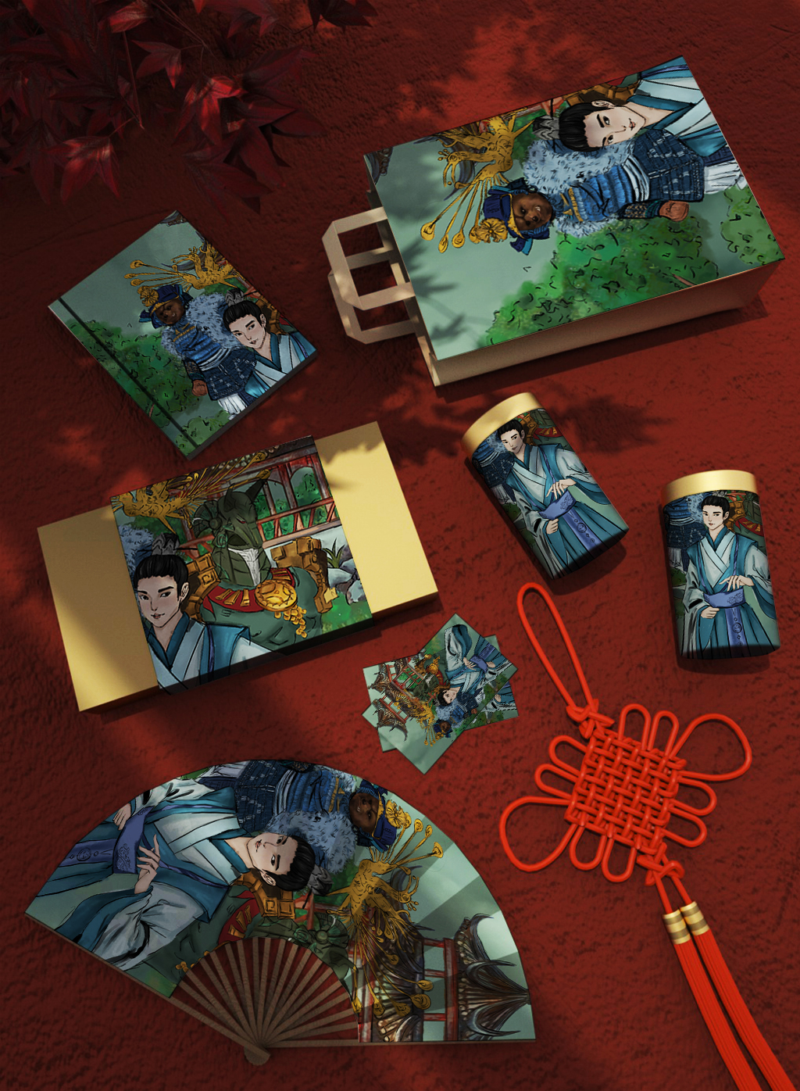
2.8中国风系列文创

